Slide 1
Bayesian Optimization
연세대학교 컴퓨터과학과 이지은
2023년 7월
과제명: IoT 환경을 위한 고성능 플래시 메모리 스토리지 기반 인메모리 분산 DBMS 연구개발
과제번호: 2017-0-00477

Slide 2
Content
정규화
Scaler
Bayesian Optimization
Surrogate Models
Acquisition Functions

Slide 3
정규화
Normalization
값의 범위(scale)를 0~1 사이의 값으로 바꾸는 것
학습 전에 scaling 하는 것
머신러닝에서 scale이 큰 feature의 영향이 비대해지는 것을 방지
딥러닝에서 Local Minima에 빠질 위험 감소(학습 속도 향상)
MinMaxScaler
Standardization
값의 범위(scale)를 평균 0, 분산 1이 되도록 변환
학습 전에 scaling 하는 것
머신러닝에서 scale이 큰 feature의 영향이 비대해지는 것을 방지
딥러닝에서 Local Minima에 빠질 위험 감소(학습 속도 향상)
정규분포를 표준정규분포로 변환하는 것과 같음
표준화로 번역하기도 함
StandardScaler
Regularization
weight를 조정하는데 규제(제약)를 거는 기법
Overfitting을 막기위해 사용함
L1 (Lasso) regularization
L2 (Lidge) regularization

Slide 4
Scaler
Standard Scaler
데이터의 최소 최대를 모를 때 사용
기존 변수의 범위를 정규 분포로 변환
이상치가 있다면 평균과 표준편차에 영향을 미치기 때문에 데이터의 확산이 달라짐
이상치가 많다면 적합하지 않음
MinMax Scaler
각 변수가 정규분포가 아니거나 표준편차가 작을 때 효과적
이상치 존재에 민감함
Robust Scaler
모든 피처가 같은 크기를 갖는다는 점이 Standard Scaler와 유사
But 평균과 분산이 아닌 중간값(median)과 사분위값(quartile)을 사용
이상치의 영향을 최소화할 수 있음
Normalizer
앞의 방법(MinMaxScaler, StandardScaler, RobustScaler)는 각 feature (column)의 통계치를 이용
그러나 Normalizer는 각 row마다 정규화를 진행
한 행의 모든 feature 사이의 Euclidean distance가 1이 되도록 데이터값을 변환
빠르게 학습이 가능하며, overfitting 확률을 낮출 수 있음

Slide 5
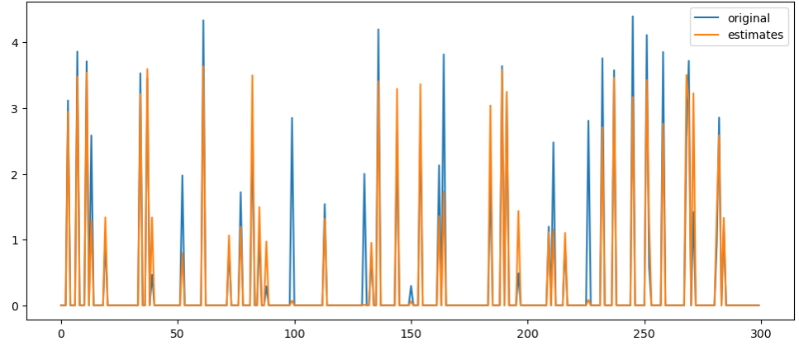
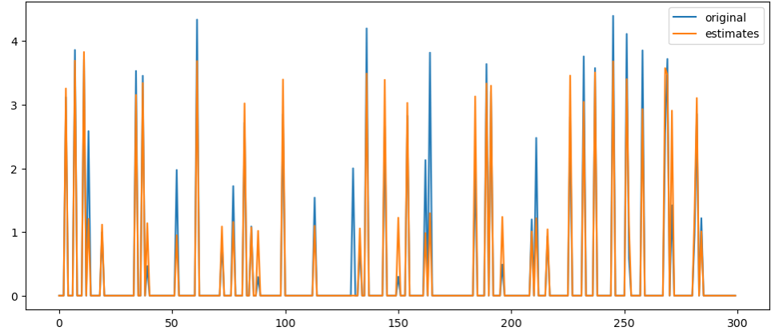
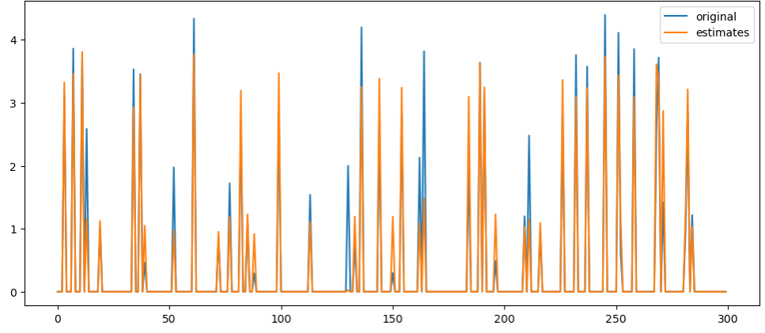
Scaler
Without Scaling (0.972977)
MinMax Scaler (0.968885)
Standard Scaler (0.972694)
Robust Scaler (0.973885)

Slide 6
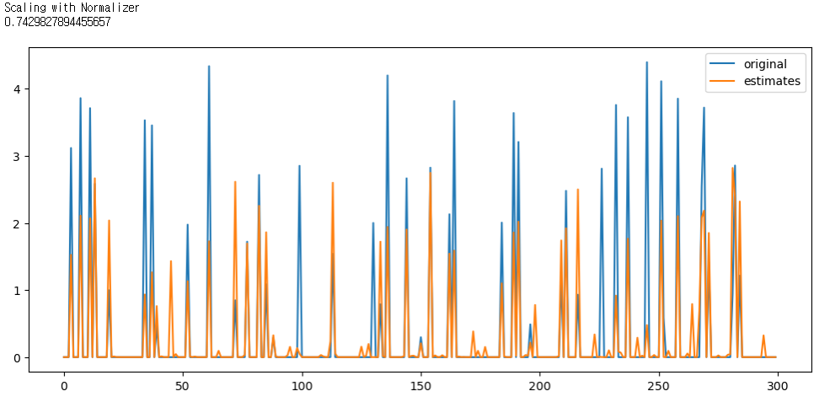
Scaler

Slide 7
Bayesian Optimization
Bayesian optimization (BO) is a popular optimization framework designed to solve black-box problems with expensive evaluation costs.
“Black-box” means that the objective function has no analytic form. We can only observe its outputs based on the given inputs, without any knowledge of its internal workings.
Examples: hyperparameter tuning, A/B testing, knobs tuning, big data platforms tuning, electronic design automation, ...
The main advantage of BO is that it estimates the uncertainty of unseen configurations and balances exploration and exploitation when selecting the next configuration to evaluate
The main problem for BO to solve is an optimization problem for an unknown objective function $f$, and we hope to find a global minimizer (or maximizer) of that function:
$$x^{∗}=\underset{x∈A}{arg min}{f(x)}$$
$A$ is a search space, $\left\{x∈ℝ^{d}:a_{i}≤x_{i}≤b_{i}\right\} or \left\{x∈ℝ^{d}:\sum_{i}{x_{i}=1}\right\}$
$d≤20$ in most successful
$x$ is a data point
noisy observation of function $f$, noted as $y_{i}=f\left(x_{i}\right)+ε, ε\sim 𝒩\left(0,σ^{2}\right) and 𝔼\left[y | x\right]=f(x)$

Slide 8
Bayesian Optimization
BO can be considered as a sequential search algorithm.
At iteration n, BO uses the evaluated information to guide the search of new location $x_{n+1}$ and get the noisy evaluation $y_{n+1}$ of the black-box function $f$.
And after N rounds of iterations, BO makes a final decision of the optimization solution and provide a solution.
BO mainly contains two key ingredients, a probabilistic surrogate model and an acquisition function.
Assumed that the black-box function $f$ is sampled from a probabilistic distribution, known as probabilistic surrogate model.
capturing the new observation information to update knowledge of the current function
The acquisition function is used to balance the exploration and exploitation trade-off to make decision of next searching point in the domain.
$$×N$$
data point
$$𝒟={\left\{x_{i},y_{i}\right\}}_{i=1}^{n}$$
surrogate
model
acquisition function
evaluate
(observe)
$𝒟=𝒟∪\{x_{n+1},y_{n+1}\}$

Slide 9
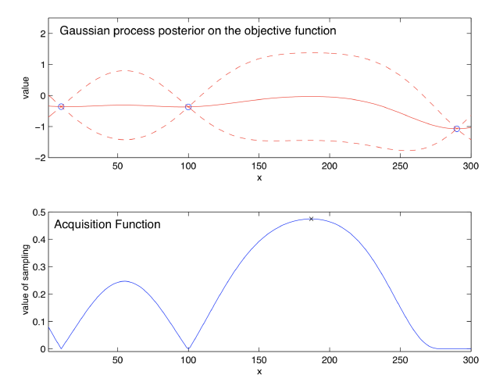
Bayesian Optimization
Illustration of BO, maximizing an objective function $f$ with a 1-dimensional continuous input
noise-free observations of the objective function $f$ at 3 points, in blue
solid red line : an estimate of $f(x)$
dashed red line : Bayesian credible intervals
similar to confidence intervals
obtained using GP regression
Bayesian optimization chooses to sample next at the point that maximizes the acquisition function, indicated here with an “x”

Slide 10
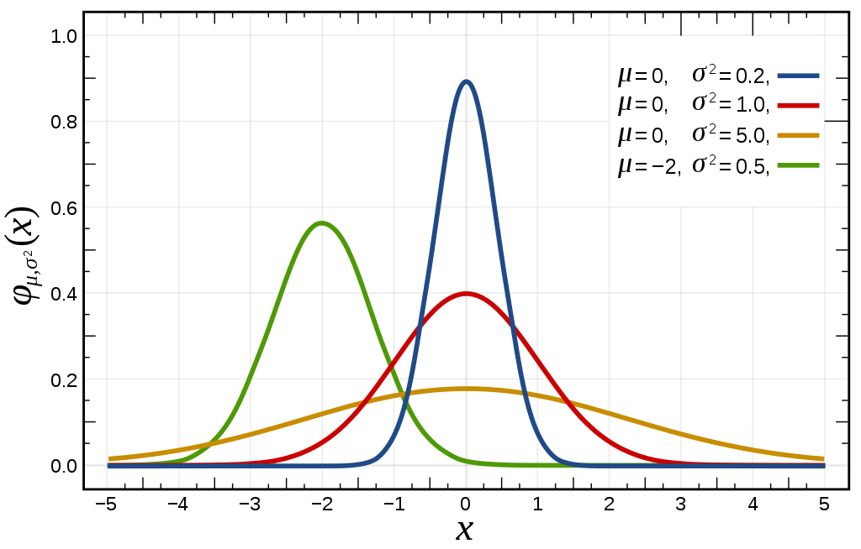
Surrogate Models
Gaussian process
If we assume prior as a Gaussian distribution, we can get the posterior by computing the mean and covariance function, which still follows a Gaussian distribution.
GP regression is a Bayesian statistical approach for modeling functions.
A finite collection of points: $x_{1},…,x_{k}∈ℝ^{d}$
Collected function’s values: $[f\left(x_{1}\right), …, f\left(x_{k}\right)]$
Prior distribution on $\left[f\left(x_{1}\right), …, f\left(x_{k}\right)\right]$ :
$$f\left(x_{1:k}\right) \sim N(μ_{0}\left(x_{1:k}\right), Σ_{0}(x_{1:k},x_{1:k})$$
$$a\left(x_{1:k}\right)=\left[a\left(x_{1}\right), …, a\left(x_{k}\right)\right]$$
Normal distribution (정규 분포, Gaussian distribution)
연속 확률 분포 중 하나
2개의 매개 변수 평균 $μ$과 표준편차 $σ$에 대해 모양이 결정됨
표기법: $N(μ,σ^{2})$
Standard normal distribution (표준 정규 분포)
평균이 0이고 표준편차가 1인 정규분포
표$기법: N(0,1)$

Slide 11
Surrogate Models
Gaussian process
A finite collection of points: $x_{1},…,x_{k}∈ℝ^{d}$
Collected function’s values: $[f\left(x_{1}\right), …, f\left(x_{k}\right)]$
Prior distribution on $\left[f\left(x_{1}\right), …, f\left(x_{k}\right)\right]$ :
$$f\left(x_{1:k}\right) \sim N (μ_{0}\left(x_{1:k}\right), Σ_{0}(x_{1:k},x_{1:k})$$
$$a\left(x_{1:k}\right)=\left[a\left(x_{1}\right), …, a\left(x_{k}\right)\right]$$
Suppose we observe $f(x_{1:n})$ without noise for some $n$ and we wish to infer the value of $f(x)$ at some new points $x$.
$k=n+1, x_{k}=x$
Posterior probability distribution (conditional distribution) :
$$f\left(x\right)|f\left(x_{1:n}\right) \sim N(μ_{n}\left(x\right),σ_{n}^{2}\left(x\right))$$
The posterior mean $μ_{n}(x)$ is a weighted average between the prior $μ_{0}(x)$ and an estimate based on the data $f\left(x_{1:n}\right)$, with a weight that depends on the kernel.
$$μ_{n}\left(x\right)=Σ_{0}\left(x, x_{1:n}\right)Σ_{0}{\left(x_{1:n},x_{1:n}\right)}^{−1}\left(f\left(x_{1:n}\right)−μ_{0}\left(x_{1:n}\right)\right)+μ_{0}(x)$$
The posterior variance $σ_{n}^{2}(x)$ is equal to the prior covariance $Σ_{0}(x,x)$ less a term that corresponds to the variance removed by observing $f(x_{1:n})$
$$σ_{n}^{2}\left(x\right)=Σ_{0}\left(x,x\right)−Σ_{0}\left(x, x_{1:n}\right)Σ_{0}{\left(x_{1:n}, x_{1:n}\right)}^{−1}Σ_{0}(x_{1:n}, x)$$

Slide 12
Surrogate Models
Gaussian process – Kernel functions
Kernels typically have the property that points closer in the input space are more strongly correlated.
If $\left\|x−x′\right\|<\left\|x−x′′\right\|,$ then $Σ_{0}\left(x,x^{′}\right)>Σ_{0}(x,x^{′′})$
Power exponential (Gaussain) kernel
$$Σ_{0}\left(x,x^{′}\right)=α_{0}\exp\left(−{\left\|x−x^{′}\right\|}^{2}\right)$$
$= \sum_{i=1}^{d}{α_{i}{\left(x_{i}−x_{i}^{′}\right)}^{2}}$ $α_{0:d}$ : parameters of the kernel
Matern kernel
$Σ_{0}\left(x,x^{′}\right)=α_{0}\frac{2^{1−ν}}{Γ\left(ν\right)}{\left(\sqrt{2ν}\left\|x−x^{′}\right\|\right)}^{ν}K_{ν}(\sqrt{2ν}\left\|x−x^{′}\right\|)$ $ν$ : parameter
Squared Exponential kernel
RBF kernel
Gaussian process – Mean function
$$μ_{0}\left(x\right)=μ+\sum_{i=1}^{p}{β_{i}ψ_{i}(x_{i})}$$

Slide 13
Surrogate Models
Random Forest (SMAC)
an ensemble of regression trees that are used to handle the problems with many input variables.
Assuming a random forest has $m$ regression trees in it, note $T_{i}$ as the predictive function of $i$-th regression tree
$μ\left(x\right)=\frac{1}{m}\sum_{i=1}^{m}{T_{i}(x)}$ $σ^{2}\left(x\right)=\frac{1}{m−1}\sum_{i=1}^{m}{{\left(T_{i}\left(x\right)−μ\left(x\right)\right)}^{2}}$
Tree Parzen Estimator (TPE)
Bayesian Neural Network
Neural Process (ICML’ 18)
Gaussian process + Neural network
GP: 확률에 기반하여 uncertainty를 잡는 것과 적은 수의 데이터로 정확한 추론 가능
NN: 학습 계산량의 scalability와 많은 데이터가 존재할 때 높은 정확도를 얻을 수 있음

Slide 14
Acquisition Functions
The acquisition function is used to balance the exploration and exploitation trade-off to make decision of next searching point in the domain.
exploration: acquiring new knowledge, and trying to expand the current observations
exploitation: trying to localize the high-performance regions within the current observations
Commonly uses acquisition function is expected improvement
There are alternate acquisition functions, such as knowledge gradient, entropy search and predictive entropy search.
These acquisition functions are most useful in exotic problems where an assumption made by expective improvement.
Expected Improvement (EI)
Derived by thought experiment.
Let $f_{n}^{∗}=\max_{m≤n}f\left(x_{m}\right)$ be the value of the optimal point.
Now suppose in fact we have one additional evaluation to perform. If we evaluate at $x$, we will observe $f(x)$.
After this new evaluation, the value of the best point we have observed will either be
$$f\left(x\right) \left(if f\left(x\right)≥f_{n}^{∗}\right) or f_{n}^{∗} \left(if f\left(x\right)≤f_{n}^{∗}\right)$$
The improvement in the value of the best observed point is
$${Improvement= \left[f\left(x\right)−f_{n}^{∗}\right]}^{+}, where a^{+}=max⁡(a,0)$$
While we would like to choose $x$ so that this improvement is large, $f(x)$ is unknown until after the evaluation.
Taking the expected value of this improvement and choosing $x$ to maximize it.
Expected improvement :
$$EI_{n}\left(x\right)≔E_{n}\left[{\left[f\left(x\right)−f_{n}^{∗}\right]}^{+}\right], where E_{n}\left[∙\right]=E[∙|x_{1:n},y_{1:n}]$$

Slide 15
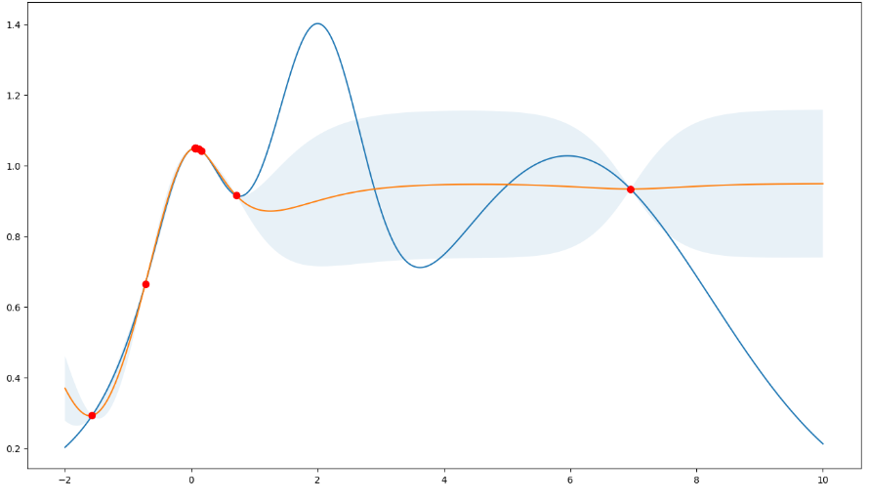
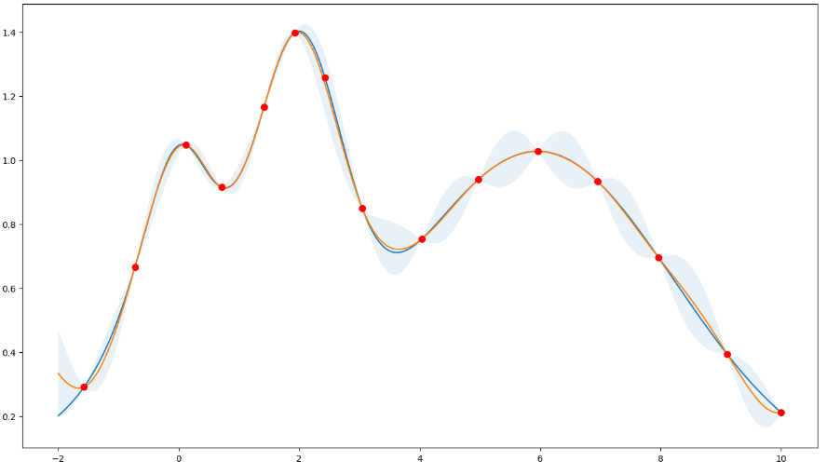
ByaesianOptimization (Python) – Acquisition Functions
Upper Confidence Bound
original
mean
credible interval
$$∙$$
new observed points
Prefer exploitation
Note that most points are around the peaks.
Prefer exploration
Note that most points are more spread out across the whole range.

Slide 16
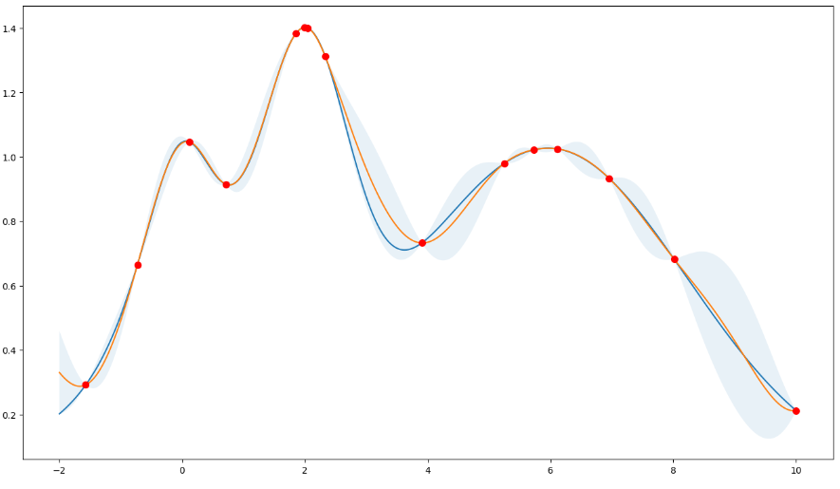
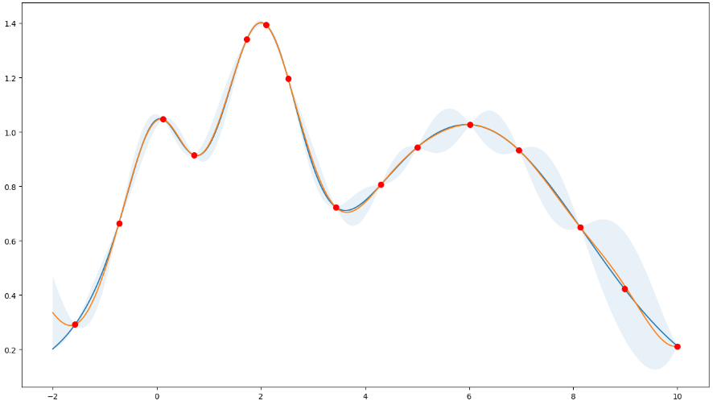
ByaesianOptimization (Python) – Acquisition Functions
Expected Improvement
original
mean
credible interval
$$∙$$
new observed points
Prefer exploitation
Note that most points are around the peaks.
Prefer exploration
Note that most points are more spread out across the whole range.

Slide 17
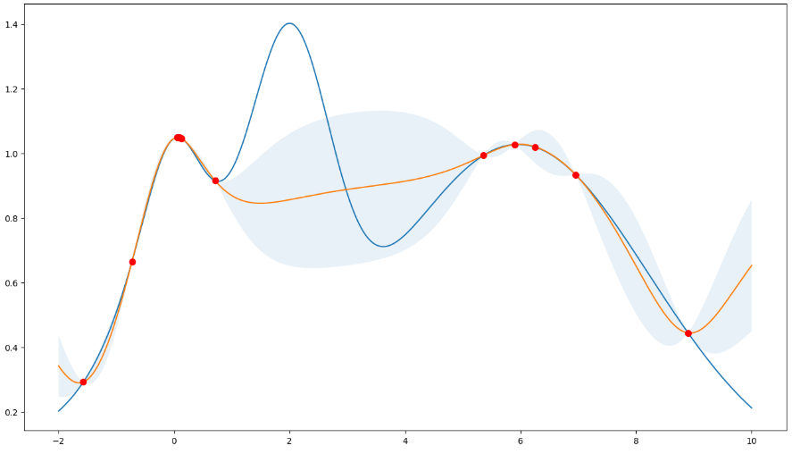
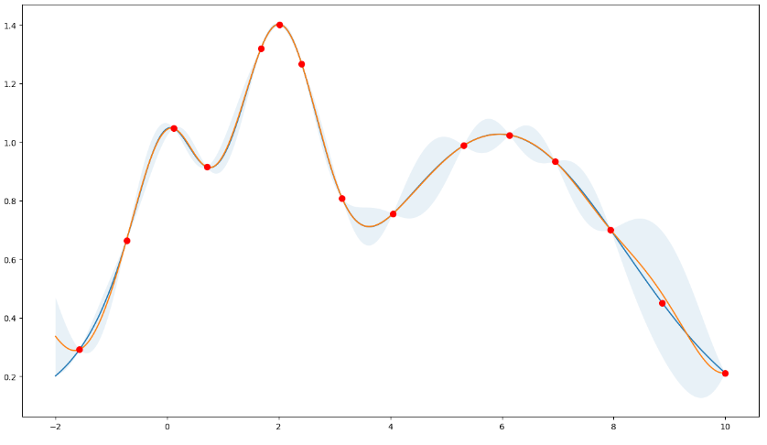
ByaesianOptimization (Python) – Acquisition Functions
Probability of Improvement
original
mean
credible interval
$$∙$$
new observed points
Prefer exploitation
Note that most points are around the peaks.
Prefer exploration
Note that most points are more spread out across the whole range.

Slide 18
ByaesianOptimization (Python) – Acquisition Functions
https://github.com/bayesian-optimization/BayesianOptimization/blob/master/examples/exploitation_vs_exploration.ipynb
Prefer exploitation
“ucb”, “ei”, “poi”
Prefer exploration

Slide 19
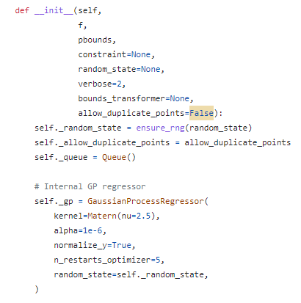
ByaesianOptimization (Python)
https://github.com/bayesian-optimization/BayesianOptimization/blob/master/examples/exploitation_vs_exploration.ipynb
Objective function
※ surrogate model 을 정의하는 부분이 아님.
GP 의 경우 해당 class에서 내부적으로 fitting함
Prefer exploitation
Prefer exploration
https://github.com/bayesian-optimization/BayesianOptimization/blob/master/bayes_opt/bayesian_optimization.py

Slide 20
References
https://realblack0.github.io/2020/03/29/normalization-standardization-regularization.html
https://dacon.io/codeshare/4526
https://mingtory.tistory.com/140
Bai, T., Li, Y., Shen, Y., Zhang, X., Zhang, W., & Cui, B. (2023). Transfer Learning for Bayesian Optimization: A Survey. arXiv preprint arXiv:2302.05927.
Williams, C. K., & Rasmussen, C. E. (2006). Gaussian processes for machine learning (Vol. 2, No. 3, p. 4). Cambridge, MA: MIT press.
Frazier, P. I. (2018). A tutorial on Bayesian optimization. arXiv preprint arXiv:1807.02811.

